Slide 1


NetCommissions Reporting Overview for Cyan users
NetCommissions

Slide 2
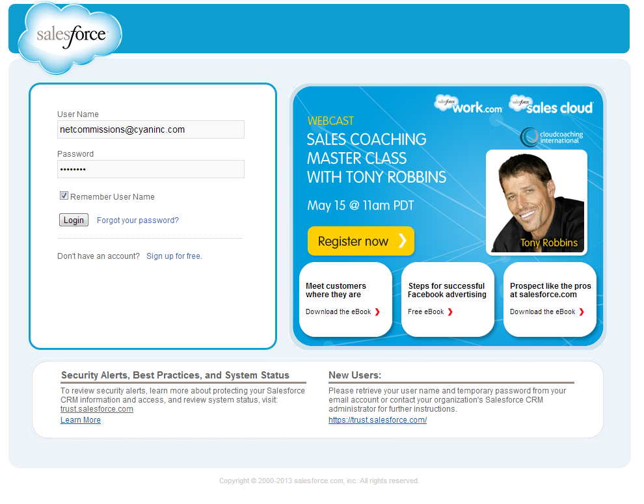
Single Sign on through Salesforce.com

Slide 3
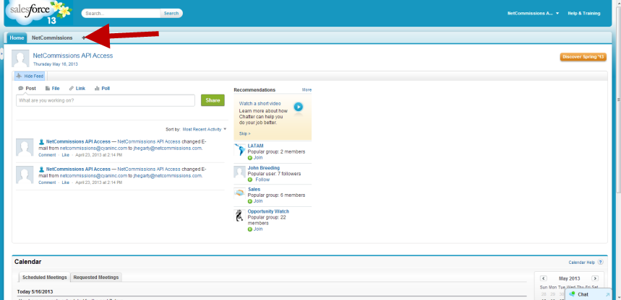
Access reports by clicking on NetCommissions Tab

Slide 4
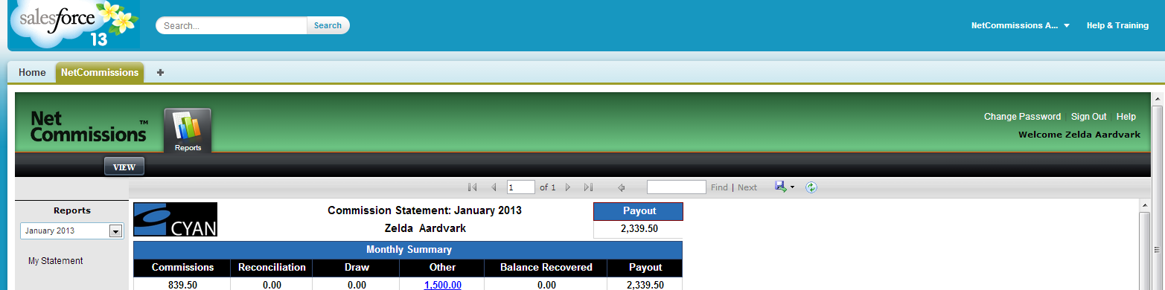
Performance Reporting – Basic Functionality
Access to Historical Reports
Click on report Name to view

Slide 5
Performance Reporting – Basic Functionality
Report Navigation Bar
Search box
Save As
  Word,
  Excel,
  PDF,
  XML,
  MHTML,
  TIFF, and CSV.
Refresh

Slide 6
Commission Statement Overview

Slide 7
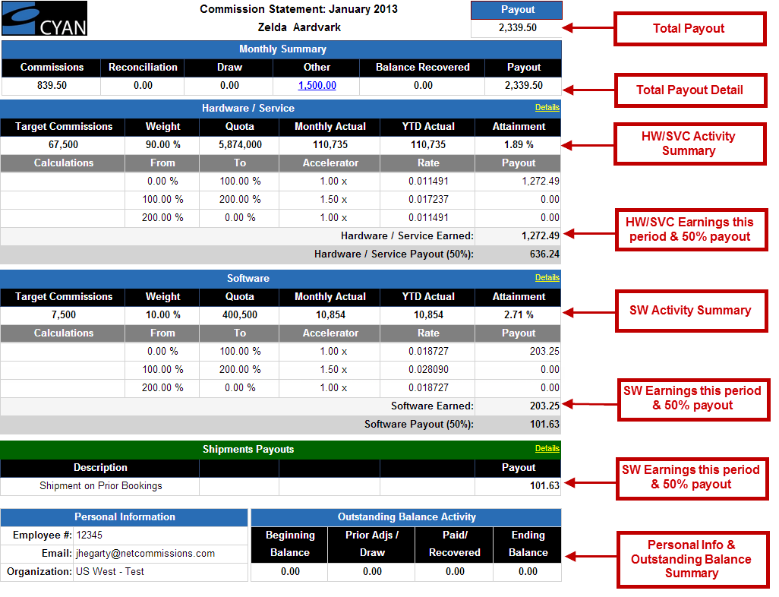
Commission Statement Overview
How much have I earned, been paid & why?

Slide 8
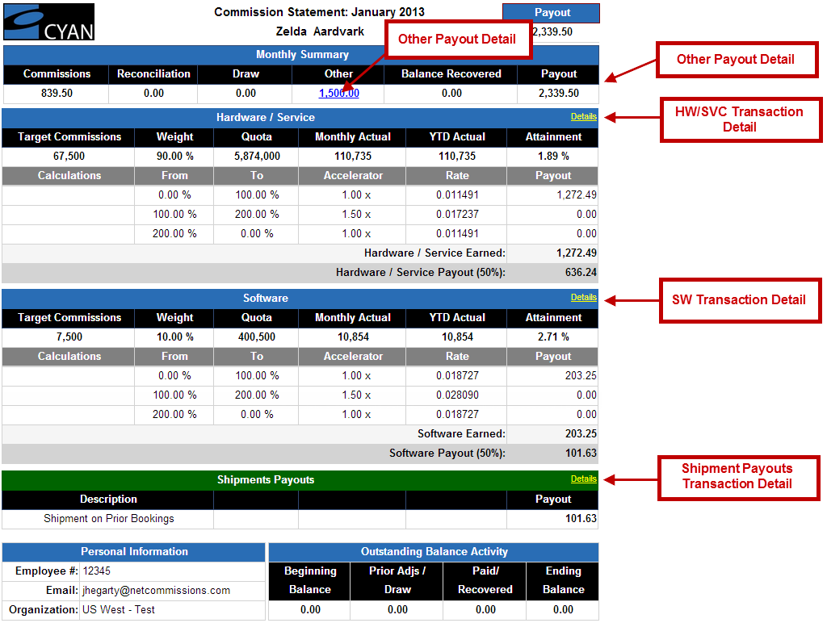
Commission Statement Overview
Highpoints

Slide 9
Sub-reports are where you all the supporting data can be found

Slide 10
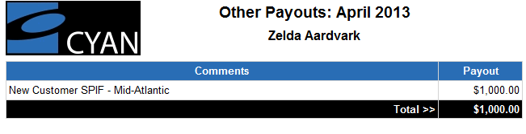
Sub reports provide additional detail
Other Payouts sub-report

Slide 11
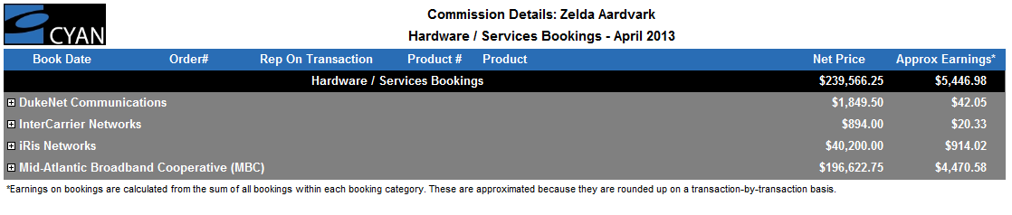
Sub reports provide additional detail
HW/Services sub-report

Slide 12
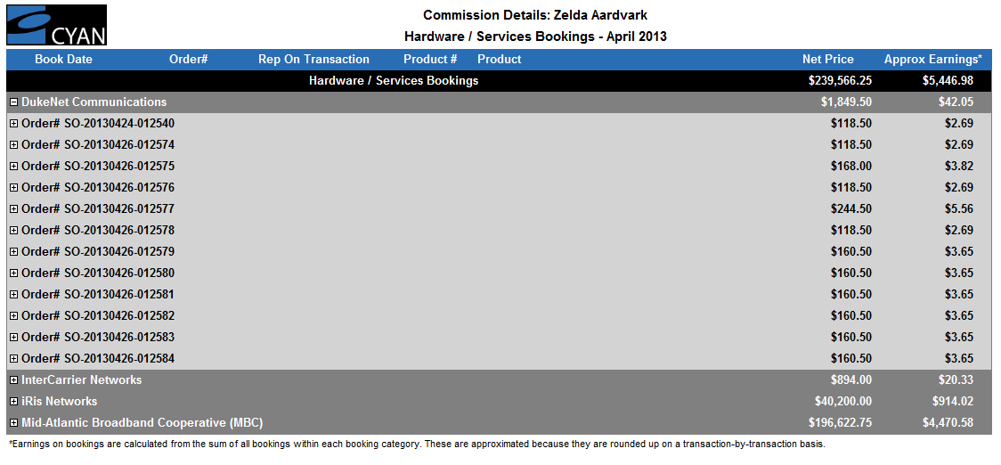
Sub reports provide additional detail
HW/Services sub-report

Slide 13
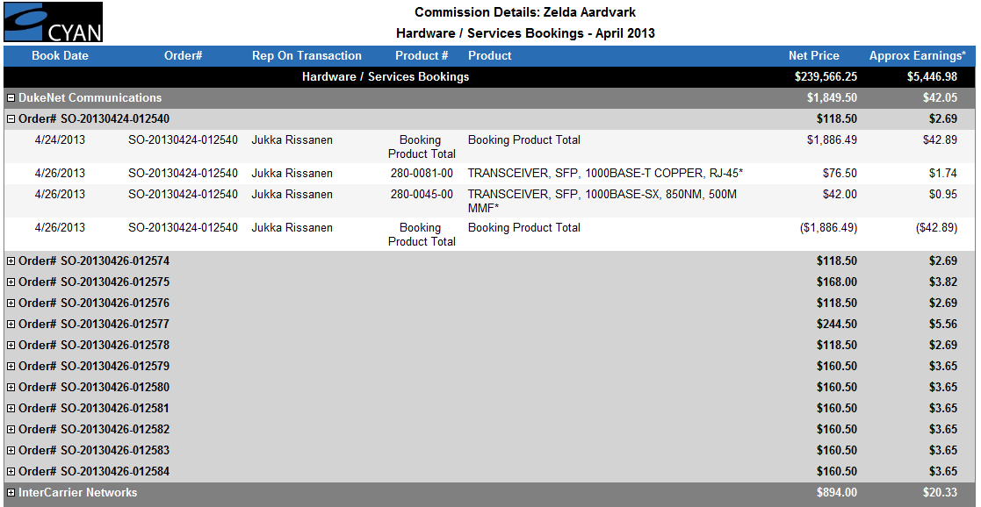
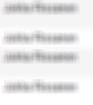
Sub reports provide additional detail
HW/Services sub-report

Slide 14
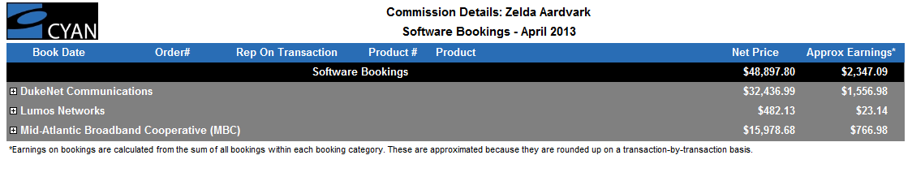
Sub reports provide additional detail
SW Bookings sub-report

Slide 15
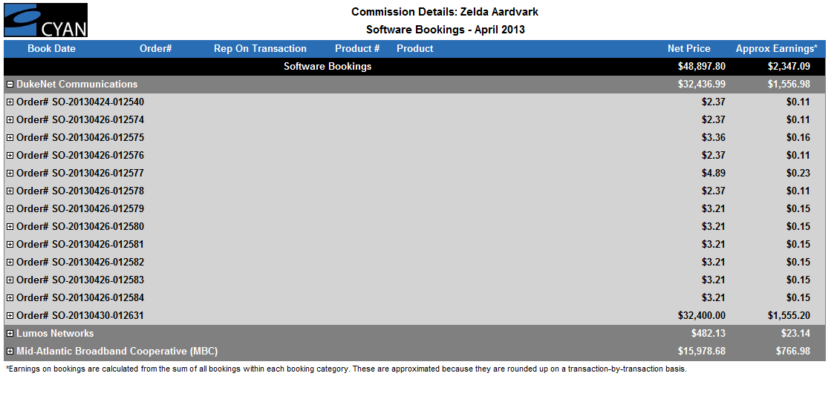
Sub reports provide additional detail
SW Bookings sub-report

Slide 16
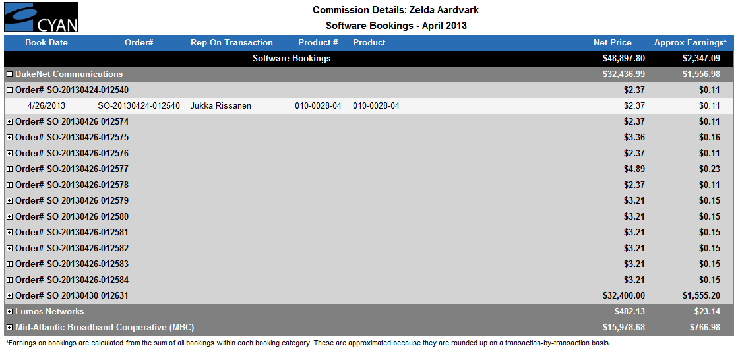
Sub reports provide additional detail
SW Bookings sub-report

Slide 17
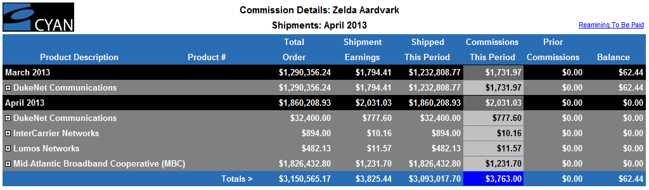
Sub reports provide additional detail
Shipments sub-report

Slide 18
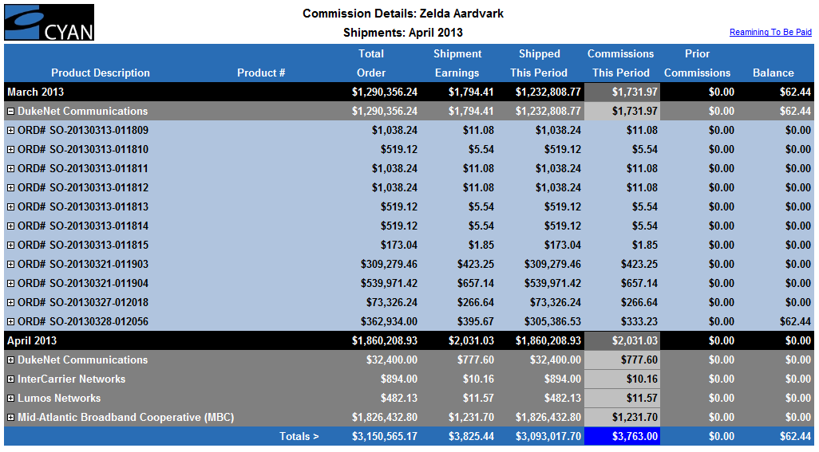
Sub reports provide additional detail
Shipments sub-report

Slide 19
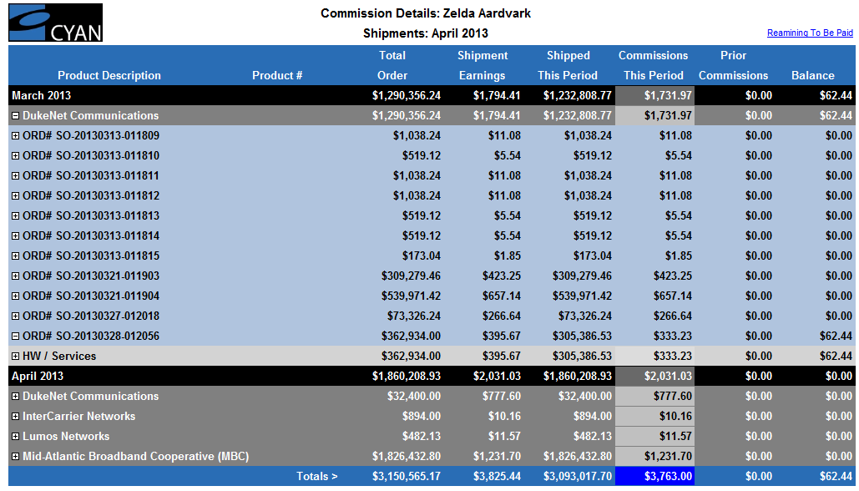
Sub reports provide additional detail
Shipments sub-report

Slide 20
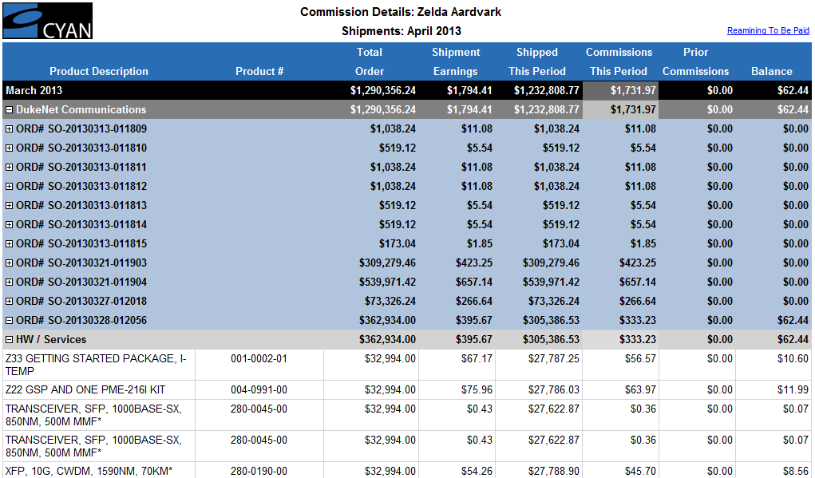
Sub reports provide additional detail
Shipments sub-report

Slide 21
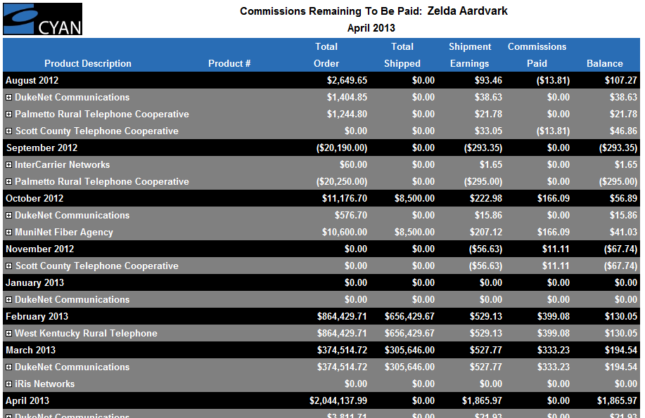
Sub reports provide additional detail
Remaining To Be Paid sub-report

Slide 22
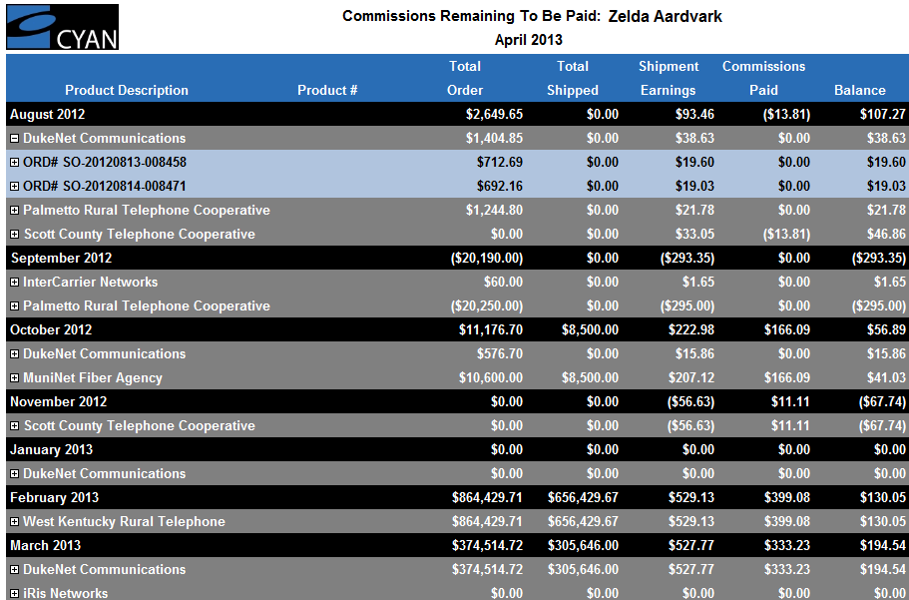
Sub reports provide additional detail
Remaining To Be Paid sub-report

Slide 23
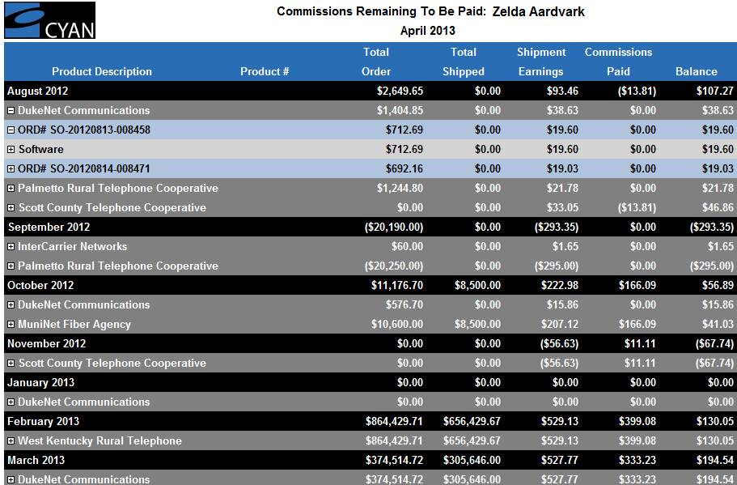
Sub reports provide additional detail
Remaining To Be Paid sub-report

Slide 24
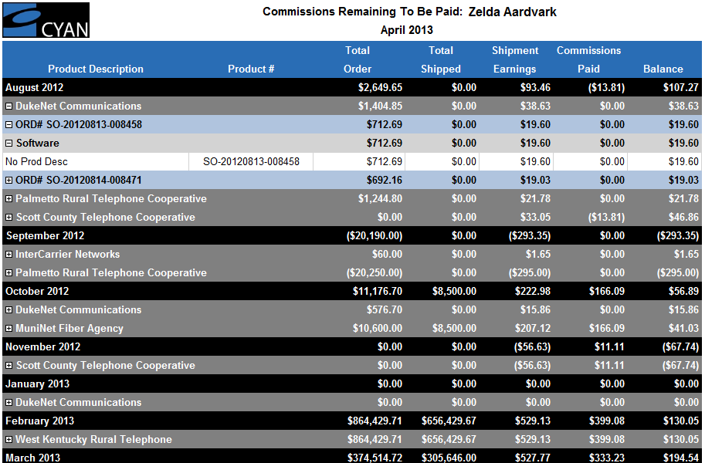
Sub reports provide additional detail
Remaining To Be Paid sub-report

Slide 25
NetCommissions Reporting Overview for Cyan users
NetCommissions

